Slide 1
Web Development

Slide 2

World before Web
https://www.123rf.com/stock-photo/letter_pigeon.html
http://www.flickr.com/photos/jm3/4683685/

Slide 3
World with the web
Things have become much easier for us.
Need some information?
Google it. Read on Wikipedia.
Need to manage your money?
Track spending with Mint. Do taxes on TurboTax.
Want to solve world poverty?
Lend money via Kiva. Contribute to Khan Academy
Want to win friends and influence people?
Connect on Facebook. Tweet on Twitter. Post on YouTube
Can even connect and talk to remote devices

Slide 4
What the web is
Web server
- Application
Database
SMTP server
Web server
Application
Web server
Application
Database
Database

Slide 5
What a web application is
Let’s examine a webpage.
https://www.flickr.com/search
Here are a few of the things that make this page work:
HTML, CSS, and JavaScript (JS).
These are the languages that make up the code that’s run by the user’s browser:
HTML specifies the content and structure of the page.
CSS specifies the layout and style of the page.
JS specifies the logic and interactivity of the page

Slide 6
What a web application is …
Stored data.
Flickr has lots of kinds of data (photos, metadata, user data, etc.). Each of these is stored in a particular way on Flickr’s back end.
For example photos are stored as files on huge file servers, while photo metadata and user data are stored in a giant DB.
Server logic.
Every time a user makes a request, Flickr’s serving stack needs to make database or even third-party calls to compile the data from which to create the page that’s returned to the user.
E.g. finding the best cat photos from Flickr’s entire corpus.

Slide 7
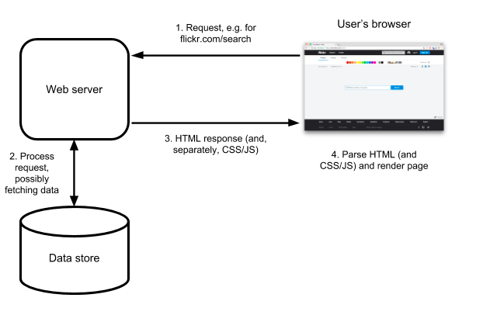
What happened in the background?

Slide 8
Primary technologies for the web
These are the technologies that we will be covering in this course.
Hypertext markup language (HTML)
Cascading style sheets (CSS)
JavaScript (JS)
NodeJS
Structured query language (SQL)

Slide 9
Hypertext markup language (HTML)
This is the language used to “write” web pages
It describes what is “on” a web page
HTML is necessary because without it, your web page is empty.

Slide 10
Cascading style sheets (CSS)
This is the language used to control the appearance of web pages.
You can control appearance of web pages using just HTML (so CSS is optional).
But web pages that don’t use CSS are ugly.

Slide 11
JavaScript (JS)
This is the language used to write the programs than run in the browser.
JavaScript is awesome because enables web pages to “feel” very interactive.
Anything you can do in JS you can also do in PHP, but it “feels” less responsive.

Slide 12
NodeJs
NodeJS is a framework used to write the server side code for the web applications using JavaScript.
Comes with a package manager.
It's one of the top platforms for JavaScript and is really fast.
There are very very many quite worthy alternatives (including PHP, Java, Ruby, and C#).

Slide 13
Structured query language (SQL)
This is the language used to tell the database what to do (including read and write data).
There are alternatives, but none of them are as widely supported or standardized.
SQL (or one of those alternatives) is typically used when you need to manage lots of data.

Slide 14
With web technologies, you can build
Your own Facebook – help people make friends and share information
Your own Kiva – help people lend money to others around the world
Your own Mint – help people track their spending and manage their money
Your own Google – help people find information from other web sites

Slide 15
What will you do with your new skills?
A better way to share information…
More specialized than Google. More flexible than Wikipedia and Yahoo Answers.
Ideas:
A website where OSU students can coach one another about which companies give good internships and which ones don’t?

Slide 16
What will you do with your new skills?
A better way to win friends and influence people…
More private than Facebook, more flexible than Twitter, less work than YouTube
Ideas:
A website where OSU students can challenge each other to sports?
A website where OSU students can offer favors (rides?) to one another?

Slide 17
And a billion other possibilities
New kinds of video games
New ways to track energy usage
New methods of learning from mistakes
New features for planning travel
New ways to meet people
New tools for learning useful skills
New ways to do anything that matters

Slide 18
Begin with the objective in mind.
What do you want to do when you graduate?
That should be the factor driving your participation in this course.
And the reason to learn what we will cover.
A project which you can put on your resume and be able to have a discussion with employer.

